Slide 1
SeenPay.net (patent) seen it and pay, the best for C2C market
Founder: Huy Le

Slide 2
Current Consumer’s Problem
of C2C & E-Commerce in Asia
Consumer fraud, privacy and security concerns
Asian consumer’s behavior is hands on inspection or purchasing
Asian consumer choose to trade within living area (city, town, province)
Asian consumers don’t trust online website/platform
No return policy or not secured

Slide 3
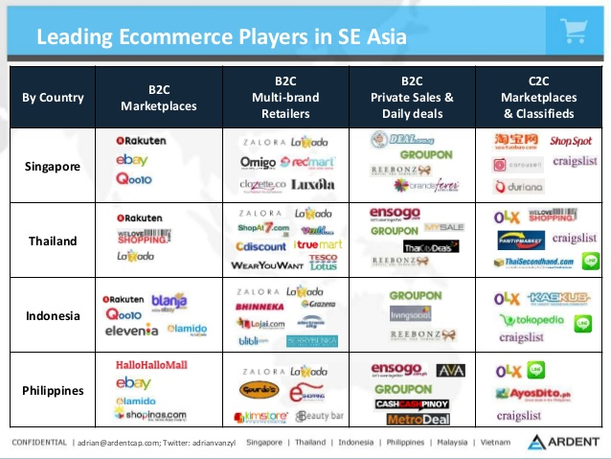

Slide 4

Why other could not success?
Why Lazada, Lelong, Zalora, Ebay, Craigslist, Amazon could not find success in Asia market?

Slide 5
Because of the difference in CULTURE

Slide 6
SeenPay, the solution
The best solution for the E-Commerce (B2C, C2C) market in Asia is SeenPay. The most safe and secured payment system which protect both Buyer & Seller which makes us different from other third-party payment system.

Slide 7
What is SeenPay?
SeenPay is a third-party online payment system which stay in the middle to protect the buyer and seller from trading items through Online Retail Market or individual/private traders, C2C market. (Amazon, Lazada, 5giay, etc.)

Slide 8
SeenPay’s Mission
SeenPay, Seen it and pay.
SeenPay aims to be the most secured payment solution in Asia for online shopping or trading regardless where the buyer or the item is located, especially used item and C2C Commerce.
SeenPay is evolving the way people trade and purchase more secured, easier and smarter.

Slide 9
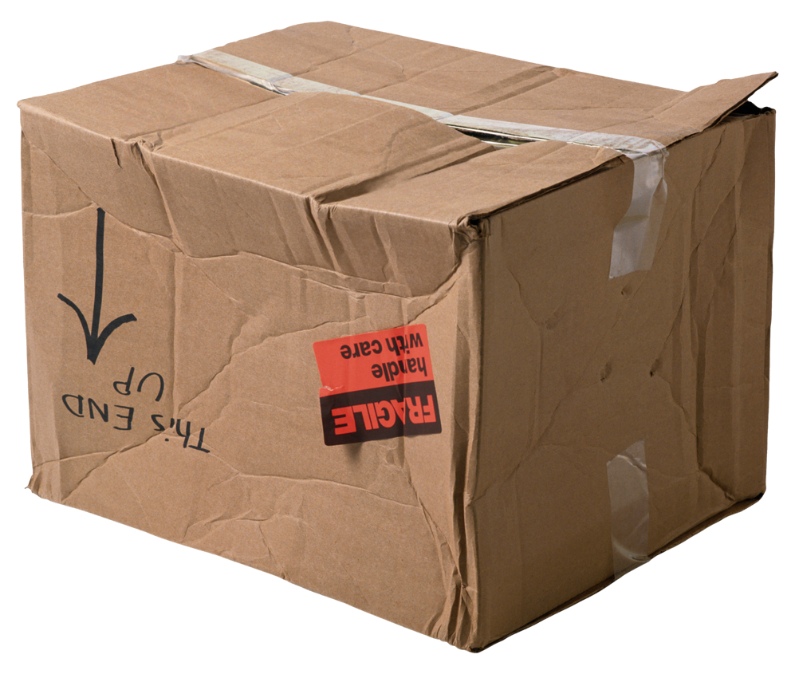
Hold - Check - Release/Return System
SeenPay RELEASE $
to Seller
SeenPay HOLD $
from Buyer
Buyer or SeenPay CHECK the item
Buyer agree about the item
if
Buyer disagree about the item
SeenPay
RETURN $
to Buyer after Buyer send item back

Slide 10
How does SeenPay work ?
Create SeenPay account or linked from the Marketplace/Classified
Buyer send money to SeenPay (SeenPay will hold the money but not release to Seller until Buyer receive the item and agree to pay)
If Buyer agree to pay, SeenPay will release the money
If Buyer want to return, SeenPay will return the money to Buyer and the product to Seller
Transaction and delivery fee is charged:
If transaction failed: Default = Buyer pay (Can be arranged by Buyer and Seller)
If transaction success: Default = Seller pay (Can be arranged by Buyer and Seller)

Slide 11
Best payment solution for Asia Market
Sorry PayPal, Why?
The Asia market is different, Asian people prefer touch and test the used item first then they can decide whether to buy or not, it means they say no to pre-paid.
Ex: Ebay & PayPal, and Amazon are failed in China

Slide 12
Spotlight on Asia’s C2C & E-Commerce Market
Largest Regional Market in 2014 and current
Asia E-Commerce Market Value (525.2 billion) > North America (482.6 billion)
Nearly 42% internet users from Asia
Asia’s goods purchasing via mobile device higher than 26% of Global’s average

Slide 13



Potential Markets
Vietnam Market (Launch 2017)
Currently Researching
ASEAN Countries
Malaysia, Cambodia, Laos, .. etc. (Long-term)
Market Research Needed
Indian Market (Long-term)
Market Research Needed

Slide 14
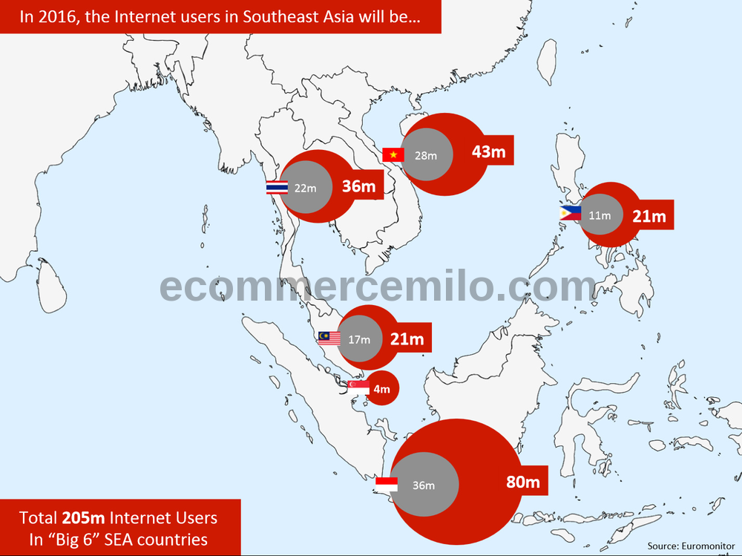
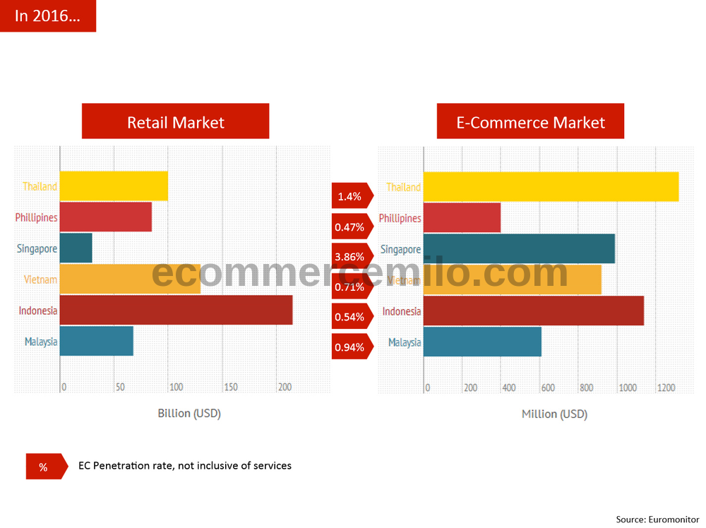
South East Asia Market (ASEAN)
205 million internet users, the number keep raising everyday seconds.

Slide 15
SeenPay Team
Name | Occupation | School | Major
Huy Le | Undergrad student | U of New Hampshire | Finance & IT
Jimmy Vo | Tech Support Engineer | EMC Corporation Hopkinton, MA
Cheryl Fong | Undergrad student | U of New Hampshire | Electrical Engineer
Thien Quang Le | Undergrad student | U of New South Wales, AUS | Information System
Binh Duc Nguyen | PWC associate | U of New Hampshire, Alumni | Finance
Rob. Tischer | Professor | U of New Hampshire | Project’s advisor
Hai Nguyen | Founder Startup.vn | Fullerton College & California State U | Project’s advisor
Michelle Le | CFO P&G China | U of Adelaide, AUS | Project’s advisor

